Slide 1
A brief introduction to autocoding
What is coding?
Notes:
So what is coding, anyone have a definition?

Slide 2
Example 1:
Job title: janitor
What was the employee doing just before the incident?
mopping floor in gym
What happened?
slipped on wet floor and fell
What part of the body was affected?
fractured right arm
What object directly harmed the employee?
wet floor
Occup: 37-2011 (Janitor)
Nature: 111 (Fracture)
Event: 422 (Fall, slipping)
Part: 420 (Arm)
Source: 6620 (Floor)
Notes:
Here’s a task we get in the office I work in
On the left is the information we collect about a work related injury
On the right, the codes we assign to indicate the characteristics of this injury, things like occupation, nature of injury, so on
We all agree this is coding?

Slide 3
Example 2:
Occupation | Wage ($ / hour)
Janitor | $15.35
Regional Manager | $3.50
Registered Nurse | $21.00
Parking Lot Attendant | $7.50
Waiter | $25,000.00
Notes:
What about this?
Here we have some information about occupations and wages collected from respondents
Your job is to go through each of these and decide whether the data was reported correctly or incorrectly

Slide 4
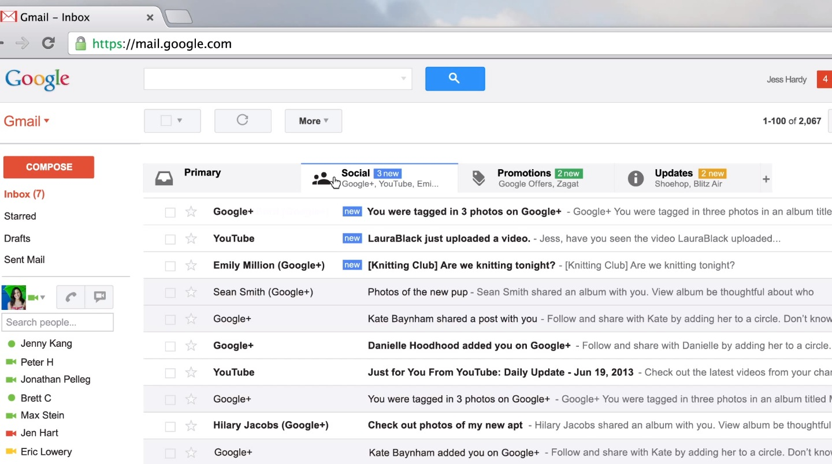
Example 3:
Notes:
Does anyone use Gmail? Gmail is an email client, it sorts your emails into these various groups, spam not spam, and then it also sorts into “Social”, “Promotions”, whatever categories you create
Is this coding?

Slide 5
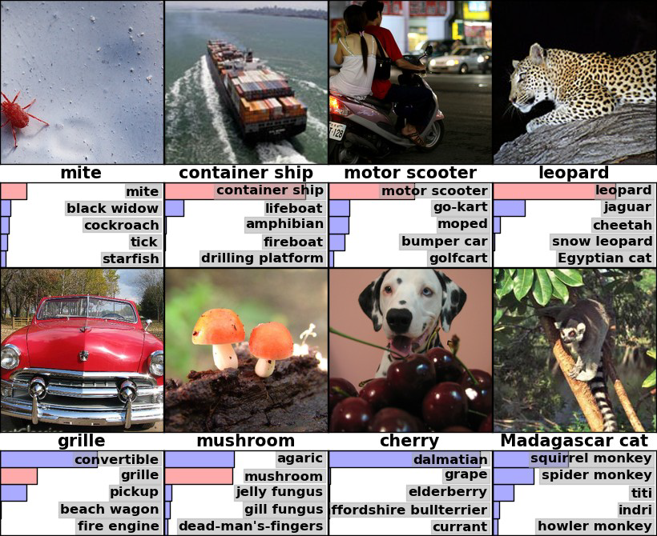
Example 4:
Notes:
Let’s start off with a simple question, what is coding?

Slide 6
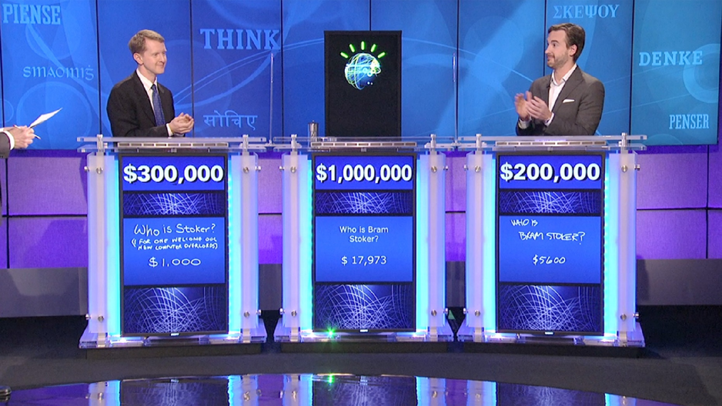
Example 5:
Notes:
Ok, here’s a tricky one
What about Watson?
Watson is this computer that plays the game show Jeopardy, a question is presented, it can be about just about anything, the contestants have to come up with an answer
You can see here, Watson is beating the world’s two best human players, Ken Jennings and Brad Rutter
Is this coding? Yes, sort of. All of these tasks are at least partly classification tasks
By classification tasks I mean you take some input, and you associate it with some classification
In coding, our classifications are just SOC codes and NAICS codes and so on
In reviewing data for errors we are classifying things as correct or incorrect
In Jeopardy they are trying to decide which, of the set of plausible answers, is the best answer for this input
Wouldn’t it be nice if we could get the computer to do our classification tasks?
No one is manually sifting through your emails for Google
No one is manually telling Watson how to answer a Jeopardy question
Why are we doing virtually all of our classification manually?
Why can’t we just use the same techniques Google and IBM are using,
We are lucky that these are the same task, it means we can learn from how these other people do it
In the Bureau of course, we do all of this classification manually, but wouldn’t it be nice if
So wouldn’t it be nice if we didn’t have to do all this coding and data review manually

Slide 7
Notes:
We don’t have to do it manually. IBM isn’t doing it manually, Google isn’t classifying emails manually, we don’t have to either.
Here, we take, in some cases the exact same techniques used by Google and IBM, we apply them to our coding task in the Survey of Occupational Injuries and Illnesses, compare it to trained human coders. Actually, humans have a big advantage here, they were reviewed by other human coders. Computer is as good as or better than human on all of these tasks
It takes humans 25,000 hours of labor to code these each year, my laptop does it in less than an hour.
It’s not only super good, it’s super easy. Amount of code needed to create a basic autocoder is less than a page.
Goal of this class is to teach you how to build these.
So, how do we get the computer to do this? Any guesses?
First step is we need to learn how to talk to the computer. The way to do that is with a programming language.
We’re going to use a language called Python

Slide 8
Why Python?
Expressive
Simple
Widely used
Notes:
Most of you have familiarity with SAS.
Heck I was very good at SAS before I knew anything about Python
Why waste everyone’s time learning some obscure language?
Actually, it’s not so obscure, it’s more widely used than SAS, Stata, SPSS, Minitab, R, and Matlab combined
It is, along with R, the standard for modern data analysis
If you take a Data Science class at Harvard or MIT or University of Chicago, or just about any other major university, they will teach you Python
You talk to the best data scientists in the world, the guys working at Google and Facebook, they’re all using Python
I was at a conference last week, the largest statistics conference in the world
Former president of the American statistical association was giving a presentation on the future of statistics, the challenges theyface
And she said:
-- employers are coming to her and saying look, it’s ncie that they know R, it’s nice that they know SAS, but we need more people that know Python
People use Python because it is expressive:
With Python you can tell the computer to do just about anything a computer can do
It is simple – it is probably the easiest full-function programming language in existence
Widely used and supported – means people have built a lot of powerful libraries for Python that we can use
So the good news is that we’re going to learn a little Python in this course
The bad news is that once learn how to program in Python you’re going to realize how horrible SAS is, and hate every second of it

Slide 9
Getting started
What is Python?
How do we use it?
Anaconda
Notes:
What is Python?
Python is really two things – it’s a written language for communicating with your computer
- it is an interpreter which translates the Python language from the code you write, into instructions the computer knows how to perform
to use Python we’re going to need to learn the language, and we’re going to need a program, called the Python interpreter, which translates that language into computer instructions
For this class we’re going to use a software distribution called Anaconda
Anaconda is a bundle of computer programs related to Python
It includes a Python interpreter to translate our Python programs into computer instructions
It includes an integrated Development Environment – really just software to make it easier for us to write and run our programs
It includes a bunch of Python libraries – these are python programs that other people have written that do very sophisticated things
You don’t need Anaconda to program in Python, you just need the interpreter, but we’re using Anaconda because we’re ultimately going to be using a bunch of very sophisticated libraries to help us automate our coding

Slide 10
Intro to Spyder
Integrated Development Environment
Program > Anaconda > Spyder
3 windows
Text editor
Just edit text
Console
Can actually send commands to Python in an interactive fashion, or run a whole text file
Inspector
File explorer – show you what files are in your current directory
Variable explorer – show you what variables currently exist in Python interpreter
Object explorer – look at documentation of Python objects
Notes:
The name of the IDE included in Anaconda is Spyder
It’s what we’re going to use to help us write and run our Python programs
I’m going to launch Spyder here, and to do that I go to: Program > Anaconda > Spyder
# Launch Spyder
Spyder consists of 3 windows
The text editor – big window on the left, this is just a fancy version of Notepad, for writing text files
The console – bottom right – where we can interactively execute Python programs
Inspector – top right – just a tool for helping us with Python
2 ways to run Python:
interactive, basically just runs a line of code
run a whole text file full of

Slide 11
Simplest program in the world
Tell the computer to write text to the console
Text that simply says “hello world”

Slide 12
Lonely programmer
Tell the computer to write text to the console
Text that simply says “hello world”
Tell the computer to say multiple things
At least 3 things

Slide 13
Quiz!
Open Spyder on your computer
Tell the computer to write “hello world” in the console
Write and run a Python program that tells the computer to print to the console

Slide 14
Variables and Strings
Things we can store:
Strings
Integers
More (hint: everything)
Notes:
Ok, we now have a very easy way of getting the computer to talk to us
Now let’s get the computer to remember something for us
We do this with variable
Here we create a variable named “x”, and assign it the value of “hello”
x = “hello”
The computer remembers this.
When I want to get this value back later, I just refer to the variable name and out it comes
For example, what happens if I do this?
print(x)
The computer sees that I am referring to a variable named x
It looks up the value associated with x in memory, and replaces x with that value
exact same as if I did:
print(“hello”)
Later, if I want to change the value associated with x, I can just do the assignment again:
x = “good bye”
print(x)
Easy stuff, right?

Slide 15
Errors
Traceback
Error Message
Notes:
What happens if we try to refer to a variable that we never created?
What happens if I type:
print(y)
You get an error message.
You’re going to see a lot of these, you need to learn how to read them.
There are 2 parts to the error message:
Traceback – shows what code was executed just before the error occurred, in this case we only have 1 line of code
Tells us the specific line of our program where the interpreter first detected the error
Shows us that line
Error Message itself, NameError: name ‘y’ is not defined
Triggered a specific type of error called the NameError, more specifically we referred to something named y, but we never told it what y should be
When you get an error message, the first thing you should do is try to figure out what it means.
I can’t tell you how many times I’ve ignored the error message and gone digging through my code, only to discover hours later that it right there in front of me
The error message is there to help you, read it
And if you don’t know what it means, Google it because Google certainly does

Slide 16
Strings
Formatters
New line
raw_input()
Notes:
Let’s talk a little bit more about strings in Python
All the text we are ultimately going to be working with will be represented by strings, we better get good with them
First thing is assembling a string from pieces
Say we have a string, and we want to put it into another thing
For example, we have someone’s name saved to a variable
We want to greet them by name when they log in.
Let’s set this up, first let’s create a variable with a value of “Alex”
What shall we name this variable?
How do we assign the value Alex?
first_name = ‘Alex’
Now we want the computer to be friendly, to say “Hello Alex”.
We can do that as follows:
greeting = “Hello %s” % (first_name)
print(greeting)
And if we have multiple values, we can do this:
last_name = ‘Measure’
print(‘hello %s %s’ % (first_name, last_name))
One last trick, if we want the computer to take an input from the console and save it as a value, we can use raw_input().
x = raw_input(‘type something, anything’)
print(x)
Alright, now we have all the ingredients to right our first little program
First thing, we want it to ask us our first name and then save whatever value we type to a variable
Now we want to say “Hello whatever your name is”
“Hello %s %s” % (first_name, last_name)
How do I do that?
Not too hard, and now you’ll always have a computer friend to ask how your day is going

Slide 17
Numbers
Integers
Floats
Notes:
Ok, our computer friend is very friendly, but kinda dumb, let’s teach the friend some math.
First we’ll introduce some basic mathematical value types in Python
First is integer, i.e. whole numbers.
To assign an integer to variable x:
x = 3
print(x)
The other basic mathematical type in Python is the float, that is a number that has decimal points
To assign a floating point to variable x:
x = 3.0
print(x)
The difference is whether you have the decimal place or not
Once you have numbers Python can do basic operations on those numbers
Addition:
x = 1 + 2
print(x)
Subtraction:
y = 5 – 3
print(y)
Multiplication:
x = 5 * 10
print(x)
Division:
z = 5 / 2
print(z)
Wait a second, 5 / 2 is not 2, what happened?
Python sees you are dividing 2 integers, it assumes the result should be an integer. There’s various ways to fix this, easiest way is to just use floats:
z = 5.0 / 2.0
print(z)
Now we got the right answer
One last trick, we can insert numbers into strings just like we did with strings
print(‘%d minus %d = %d’ % (10, 4, 6))

Slide 18
Quiz:
Write a program that asks the user for one number, then asks for another number, then prints out a string which shows the 2 numbers that were asked for and their product.
For example, if the first number is 1, the second is 2, it will say:
1 * 2 = 2
Notes:
Now use your program to find the answer to 256 * 392

Slide 19
Boolean Logic
6 comparison operators
boolean expression
3 logical operators
(expression 1) and (expression 2)
(expression 1) or (expression 2)
not (expression 1)
Notes:
It was not that long ago that we had a program that could only repeat what we said to it
Now we have something that can ask us for information, take that information, and tell us answers to math questions we might not even know ourselves
We’re going to make our programs even smarter now, by adding logic, Boolean logic
Boolean logic refers to reasoning about things that are either True or False
In Python, we have special value types set aside just for these
x = True (notice no quotes on this, it’s not a string)
print(x)
x = False (no quotes on this either)
print(x)
Boolean values often result from comparisons
In Python some simple mathematical comparisons
> (3 > 4)
<
>=
<=
== (3==4)
!= (3!=4)
Can also do this with strings, particularly equals and not equals
x = ‘hello’
‘hello’ == x
3 logical operators: combine Boolean expressions
and – only True if both expressions are True, otherwise False
or – only False if both expressions are False
not – the opposite of whatever expression

Slide 20
Conditionals
if
else if
else

